Slide 1
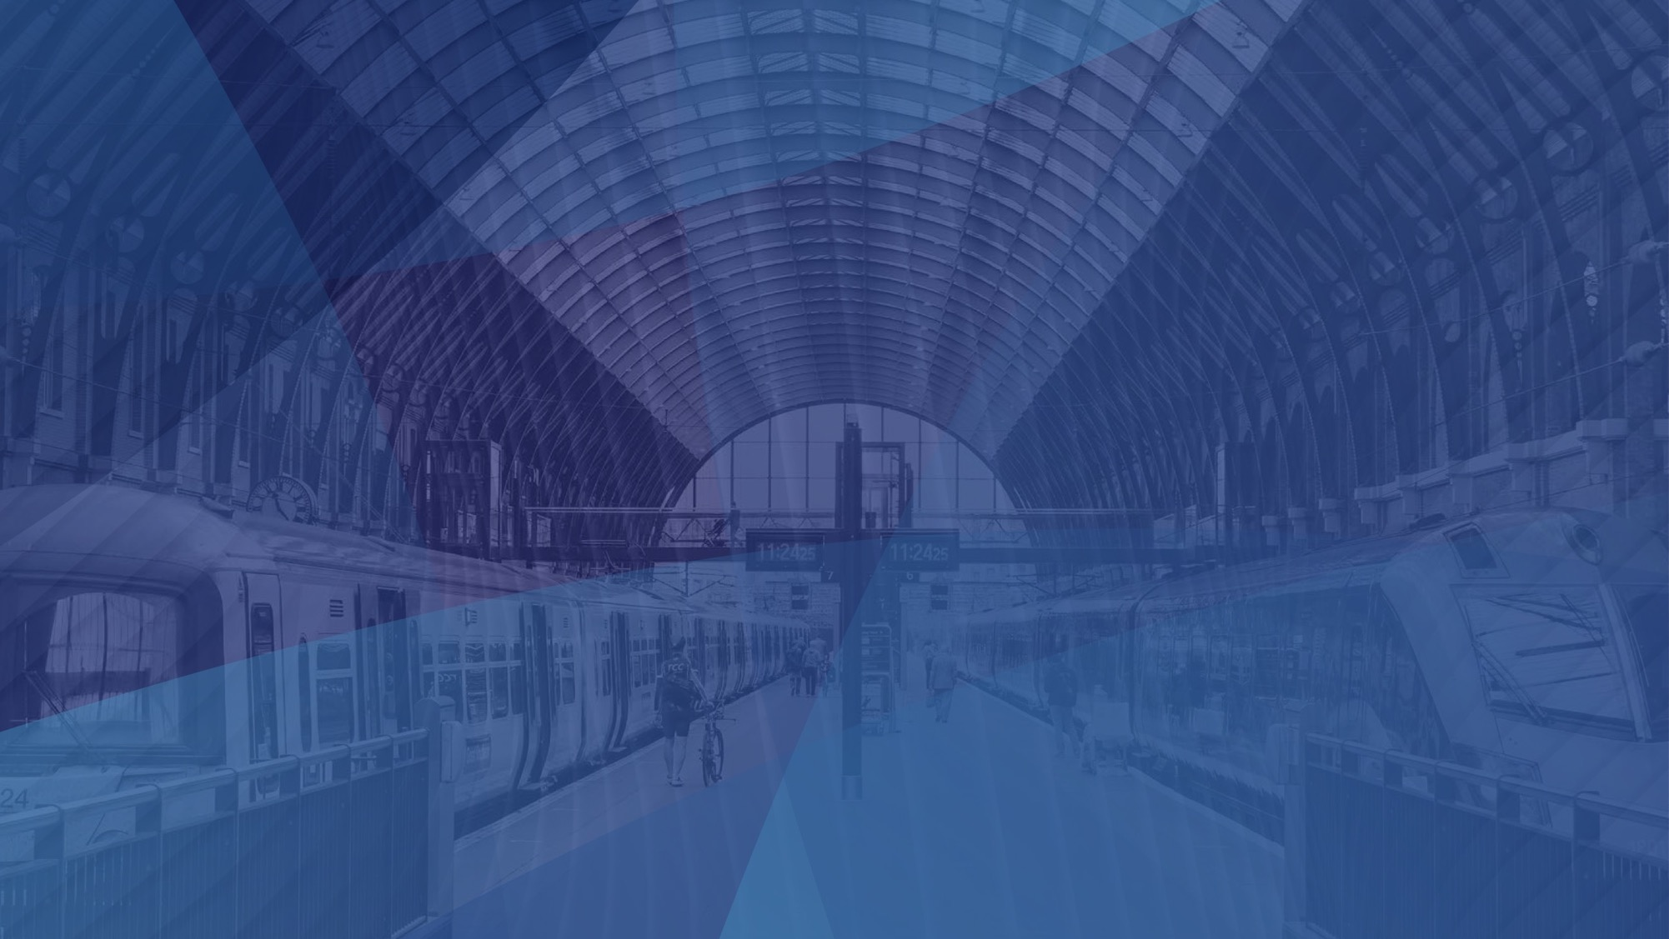
t
Why the Global Rail Industry Needs to Harness the Power of Cloud
Richard Wood, Marketing Director
Emeg Group & Emeg Rail Systems LLC

Slide 2
A Growing Problem
The rail industry is set to face new challenges in the coming years.
The number of rail passengers continues to grow.
Bigger and better rail networks and infrastructure will be needed.
Investment in the right technology is crucial.
Tech can improve the passenger experience and depot-side operations.

Slide 3
Improving the Rail Experience
Customer expectations are changing – the bar is constantly rising.
Passengers want a personalised, comfortable, reliable, hassle-free experience.
Disruptive tech can help you achieve this.
Cloud tech gives global rail operators more flexibility and agility.
A consumer-centric approach shouldn’t be limited to passengers.

Slide 4
Operational Reliability & Efficiency
Cloud brings improved operational efficiency.
“Open” interactive systems connect everything in your depot.
“Smart” networks allow for greater flexibility, scalability and cost savings.
Cloud also improves industry-wide communication and collaboration.
Scalability, reliability and flexibility are key to solving operational challenges.

Slide 5
All Change for the Climate
Rail is the most environmentally-friendly way to travel.
Passengers are aware and applaud operators who embrace green- and clean-tech.
Visible green initiatives only tell half the story.
Greater efficiencies can be found with cloud-based control networks.
Resource management systems like Emeg’s depotCONNECT® help reduce the rail industry’s impact by providing insights for ‘capacity vs. demand’.

Slide 6
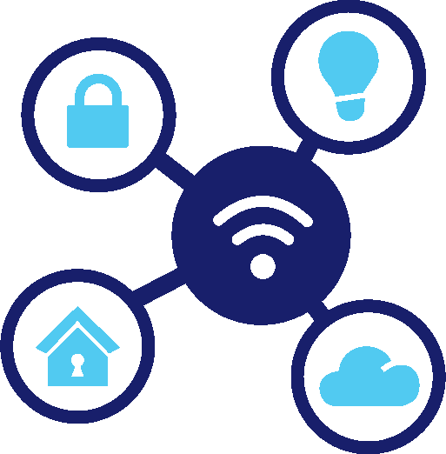
Cloud Computing & Remote Monitoring
IoT devices, systems & services are commonplace in the rail sector.
Remote monitoring plays a huge part in rail safety – safeNet™ DPS.
IoT sensors can detect things like bridge strikes.
Tech prevents serious accidents and reduces delays on rail services.
depotCONNECT® monitors any “thing”, logging data & insights 24/7.

Slide 7
Will Cloud Catch On in the Rail Industry?
Yes.
Mentions of “cloud” in rail company filings have risen by 162% since 2016.
SaaS was the most popular sub-theme with 67% of all cloud-related mentions.
Rail companies that embrace disruptive tech are seen as more robust and capable.
Get on the cloud if you want to weather future storms!

Slide 8
How Emeg has Embraced Cloud Tech
depotCONNECT® – our smart rail system integration platform.
Gives rail operators full visibility and control over their depot systems.
Automation provides greater process efficiency & increased productivity.
Remote monitoring – fewer site visits & false alarms = resource efficiency.
Provides insights that can result in reductions in power consumption.

Slide 9
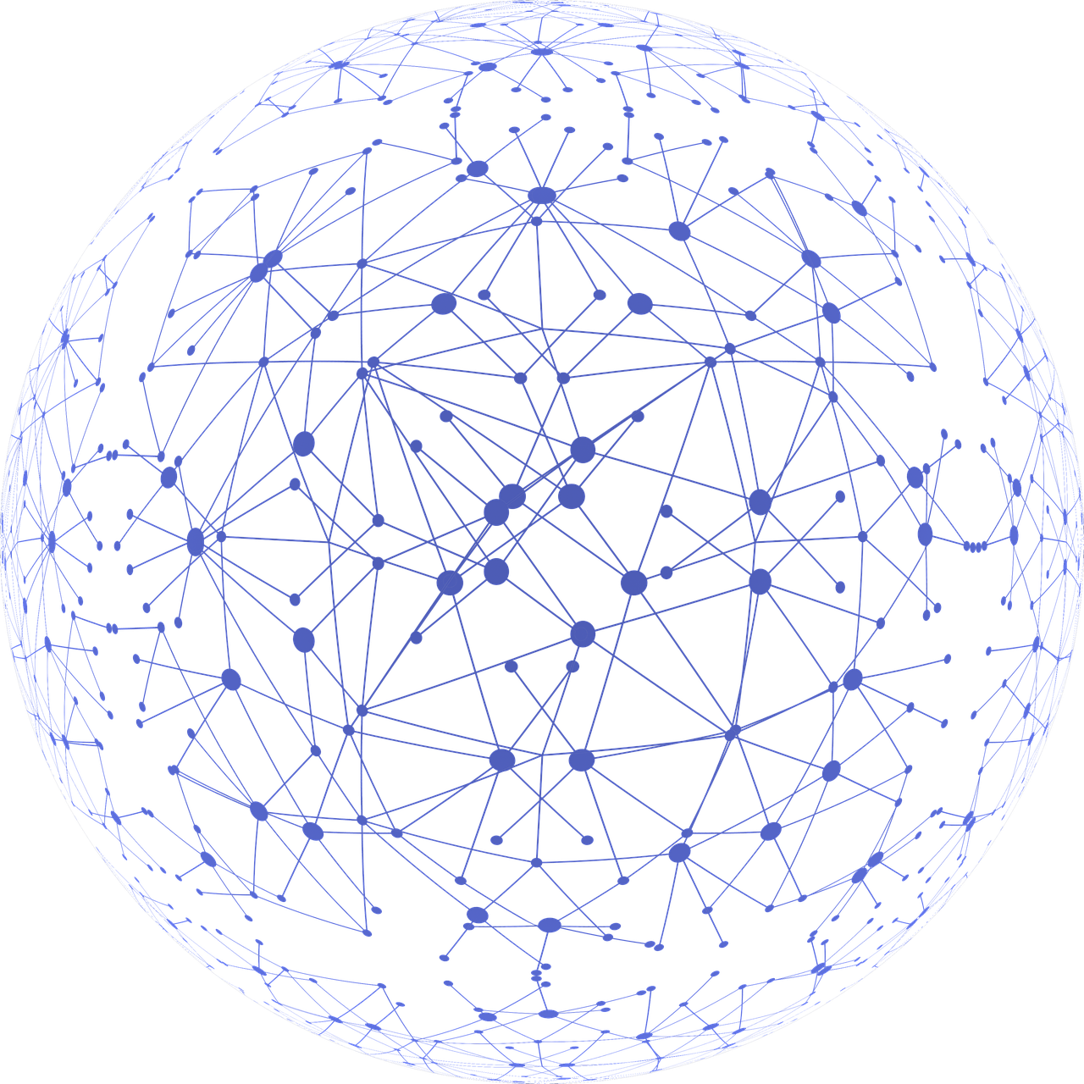
depotCONNECT® Features
Remote run-time, cycle, tank level, power and alarm monitoring.
Data logging, cloud storage and secure communications.
RFID tagging, operator log on and train servicing tracking.
Full audit trail for network-wide transparency.
Analytics and system process optimisation.

Slide 11
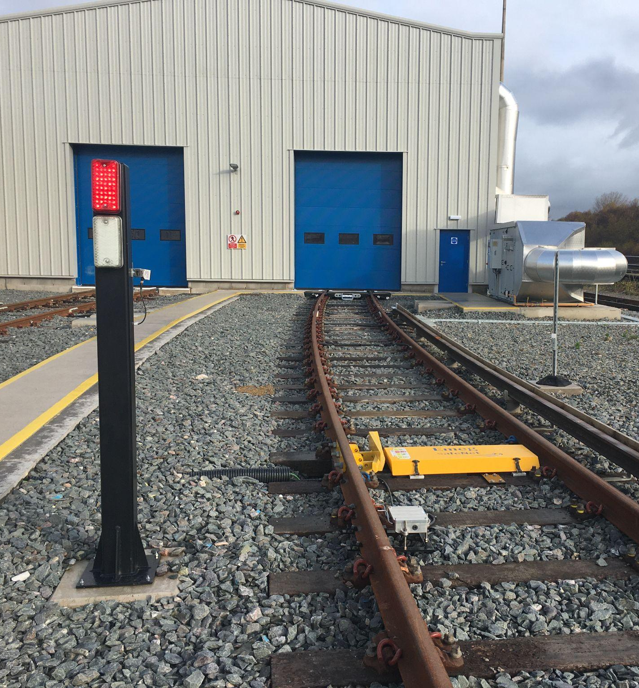
How Emeg has Embraced Cloud Tech
safeNet™ – our market-leading depot protection system (DPS).
The world’s first DPS with integrated facial recognition technology.
Fully compatible with depotCONNECT® for remote monitoring.
Network Rail PADS-approved.
SIL2 compliant – safeNet™ exceeds the requirements of SIL2.

Slide 12
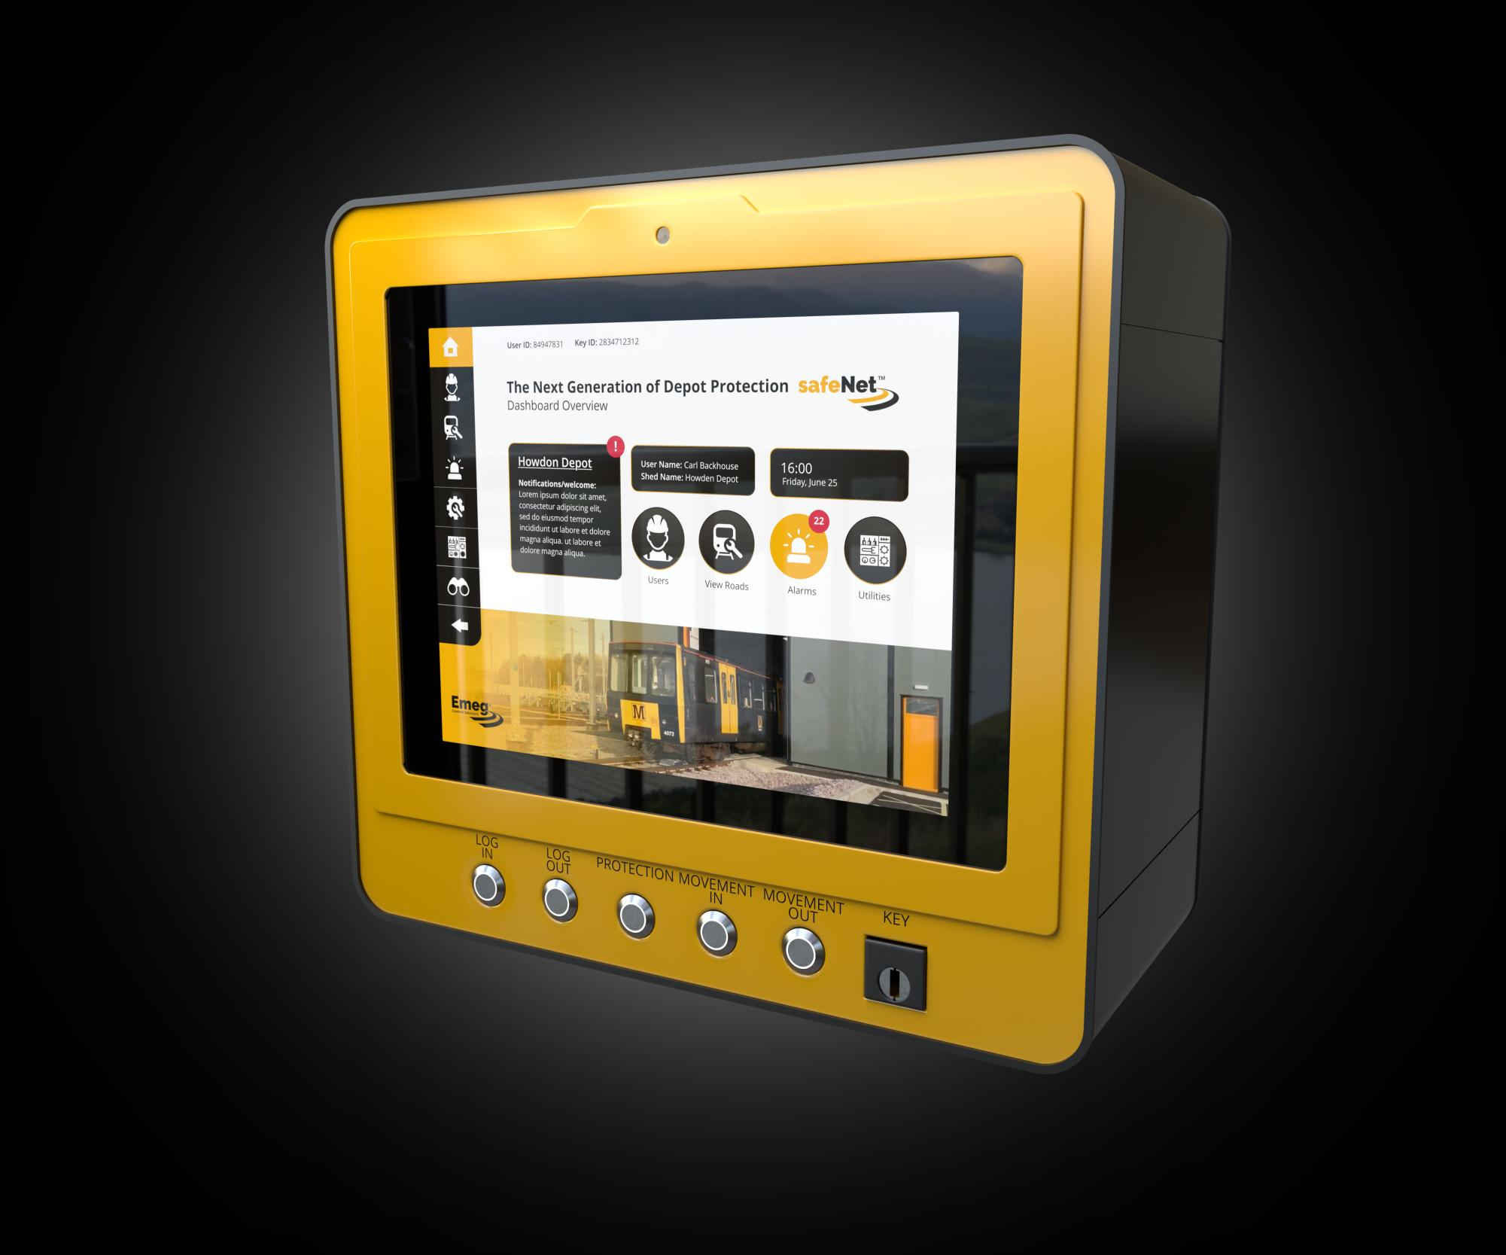
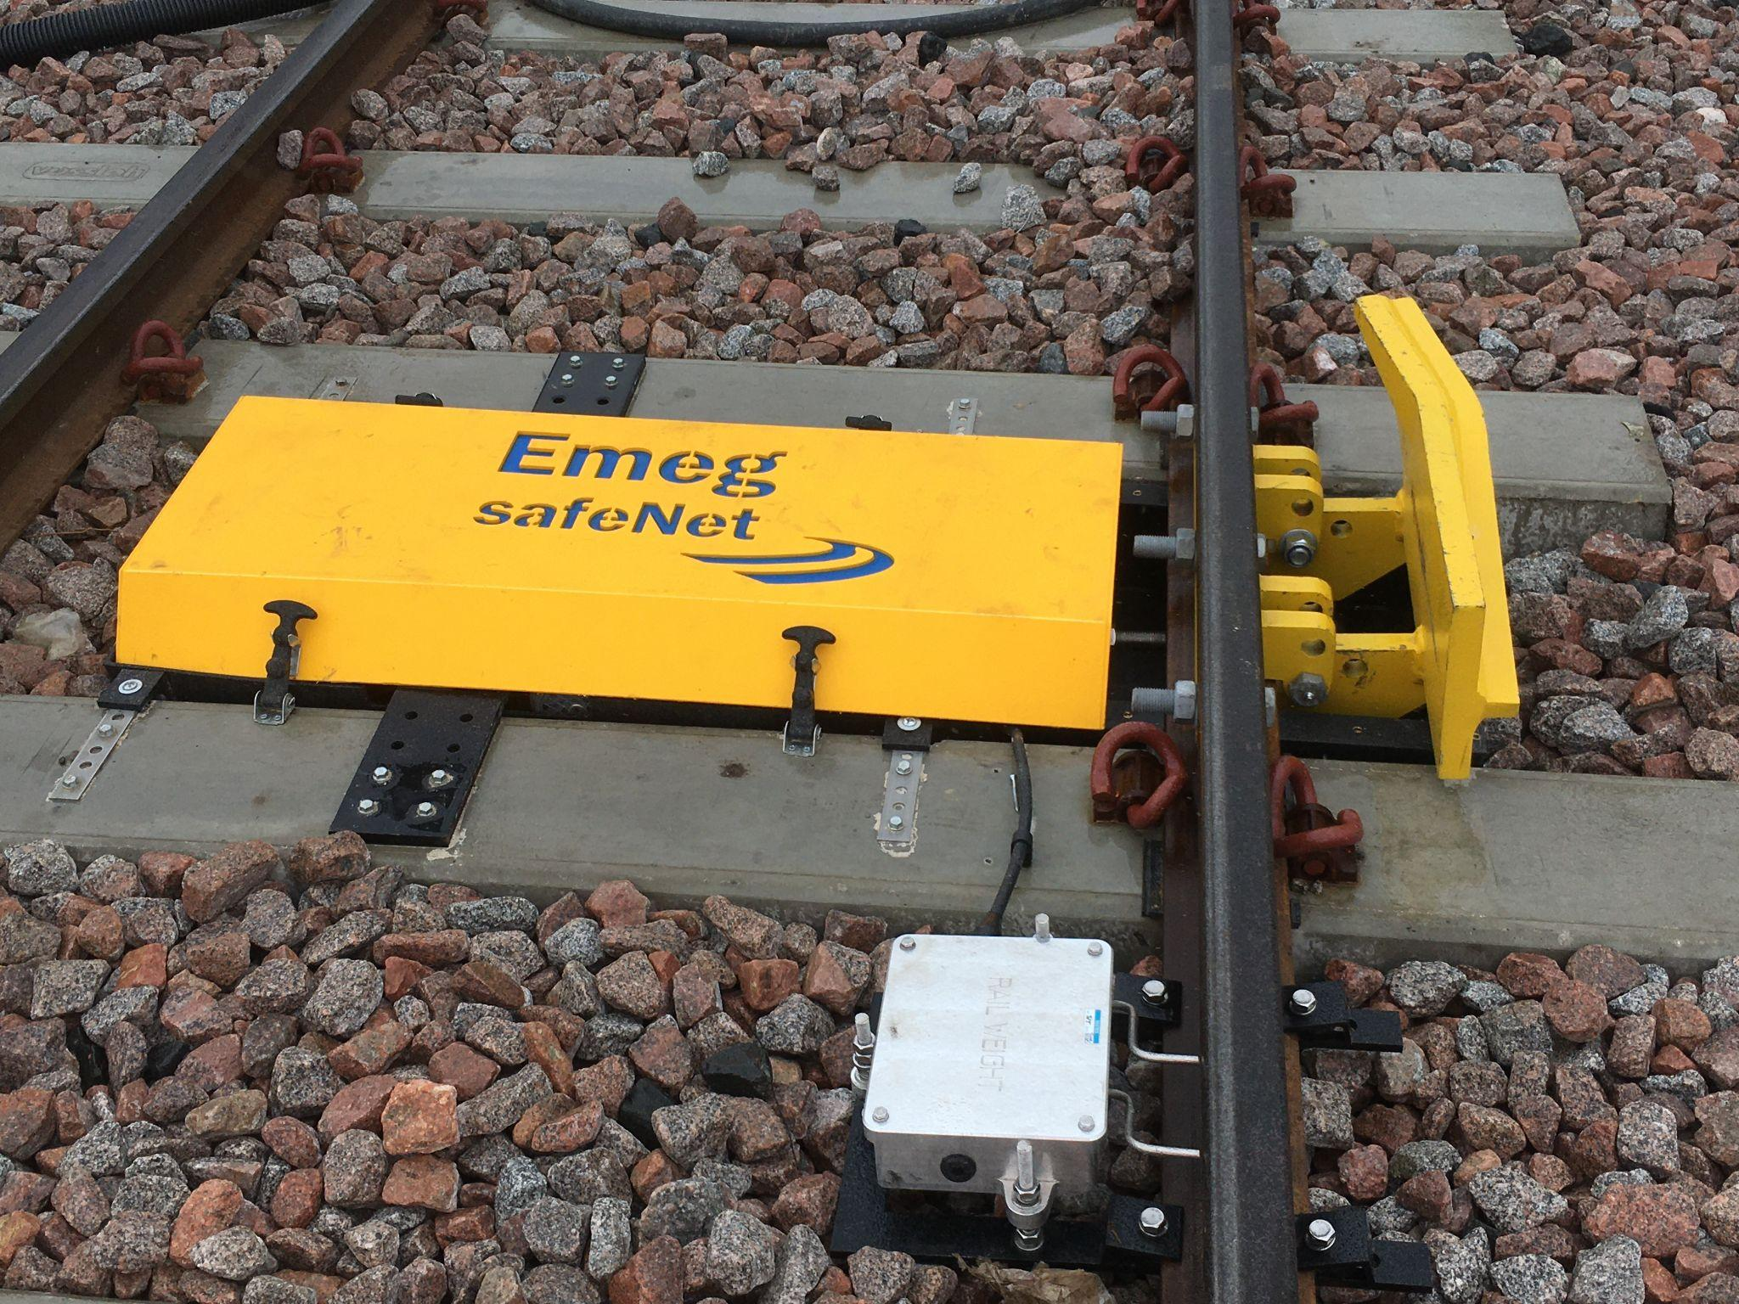
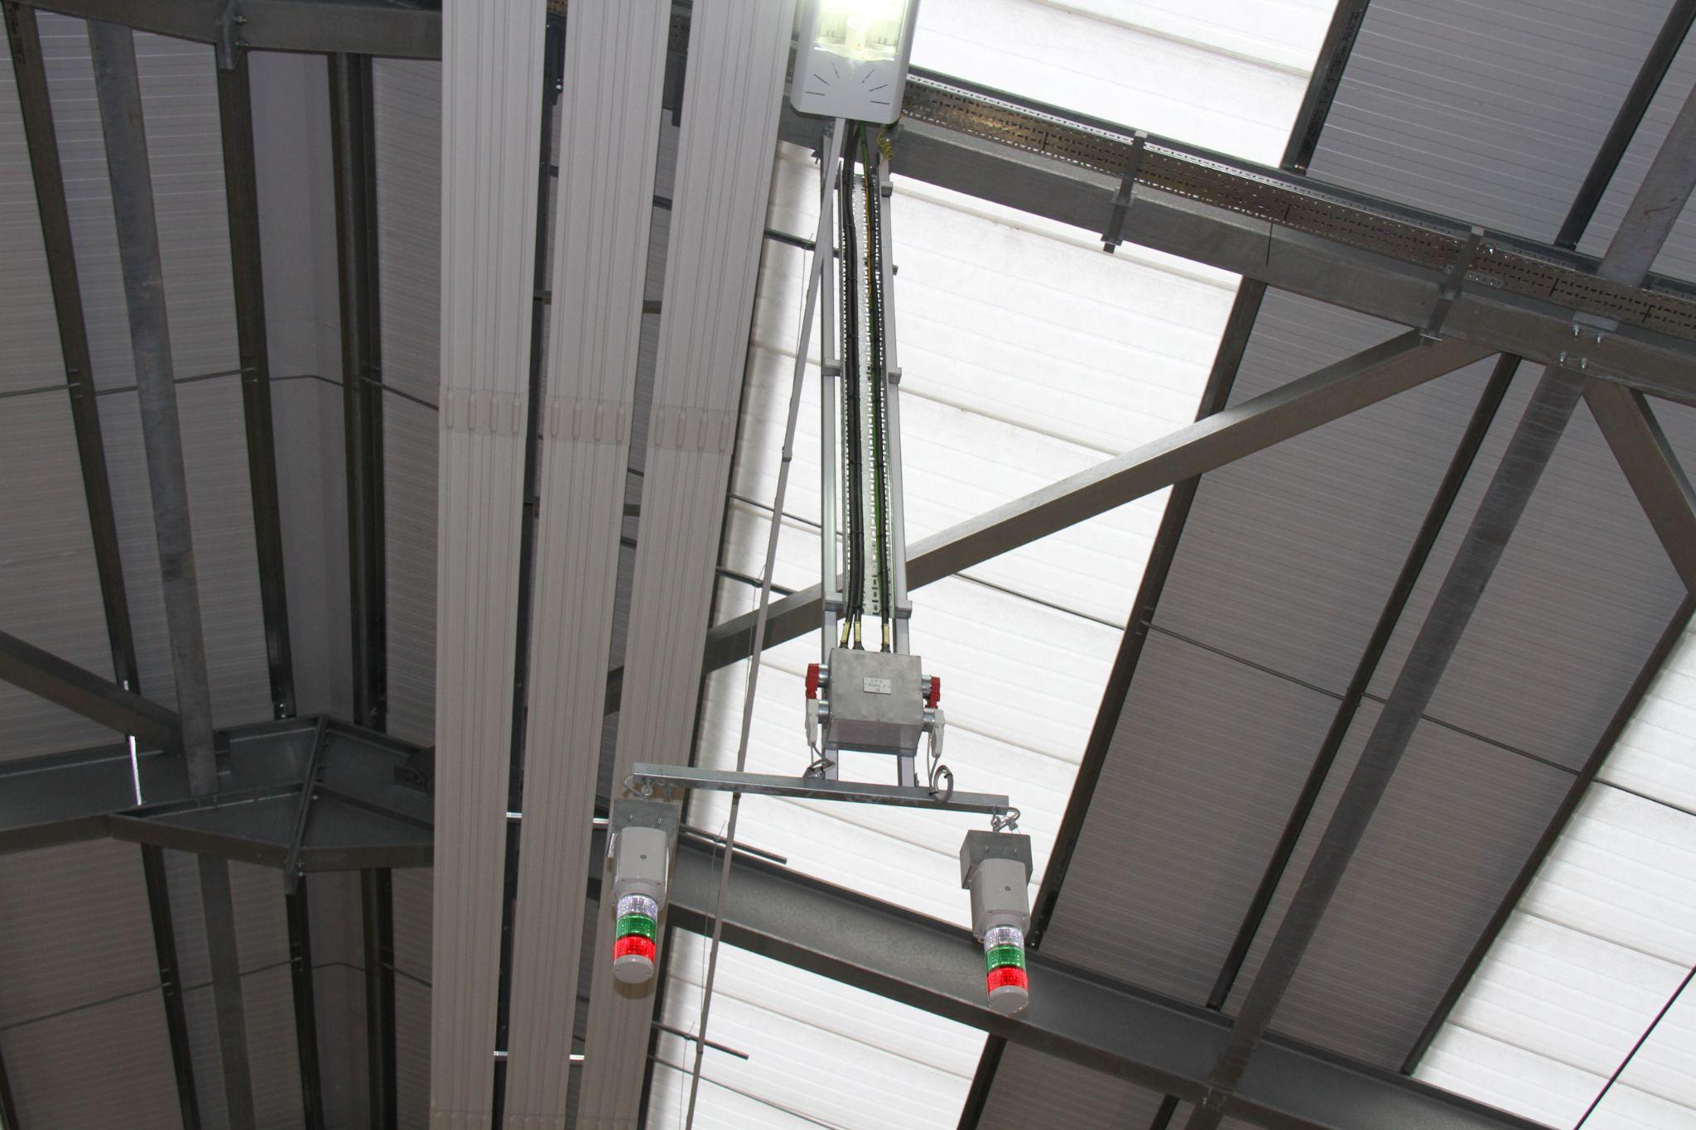
safeNet™ Features
Individual data keys and facial recognition for operators.
Intelligent sensors to detect train movement within the depot.
Sensors linked to automatic derailer and visual/audible warning systems.
Interactive, real-time views of your depot operation.
Data logging and cloud-based audit trail via secure servers.

Slide 13
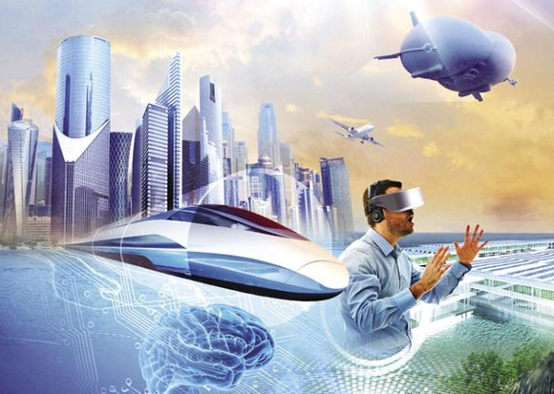
The Future of Cloud in the Rail Industry
All aboard the 5G bandwidth bandwagon! Data-powered wearable tech.
Sophisticated rail systems deployed in even the most remote of locations.
AR devices & wearables for inspections, fault diagnosis, maintenance & design. And… Engaging passengers in the Metaverse using Big Data.
Real-time smart laser scanning for BIM & 3D modelling, e.g. Emeg’s e-scan™.
Cloud data logging, diagnostics & insights gathering for bespoke solutions.

Slide 14
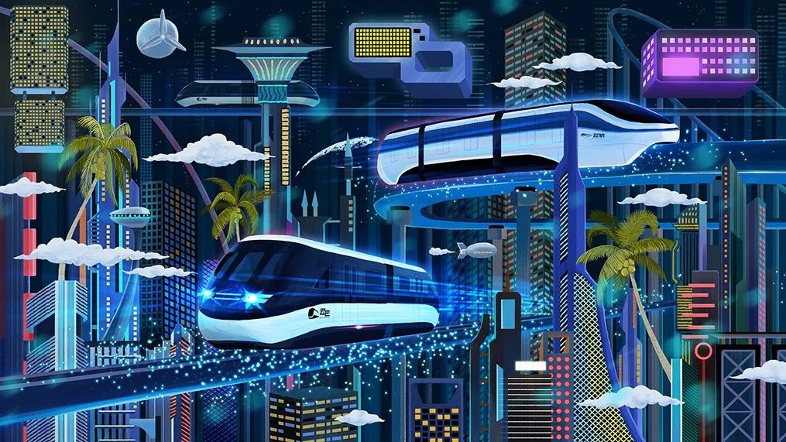
How to Transverse the Metaverse
Be authentic.
Provide value, not gimmicks.
Put yourself in your passengers’ virtual shoes.
Move fast and break things.
Careful what you capture.

Slide 15
The Future of Cloud in the Rail Industry
Carbon reporting – every rail journey includes ticket price and carbon cost.
Carbon offsetting – green initiatives to mitigate the cost of cloud computing.
More solar-powered, ultra-low-power IoT devices across rail networks.
The robots are coming – AI and machine learning take over depot management?
First come the self-driving trains, then it’s the Terminators…

Slide 16
Thank you
Any questions?
Richard Wood
Marketing Director, Emeg Group
UAE Office: +971 04 568 6798 | sales@emegrailsystems.com | www.emegrailsystems.com

